Slide 1
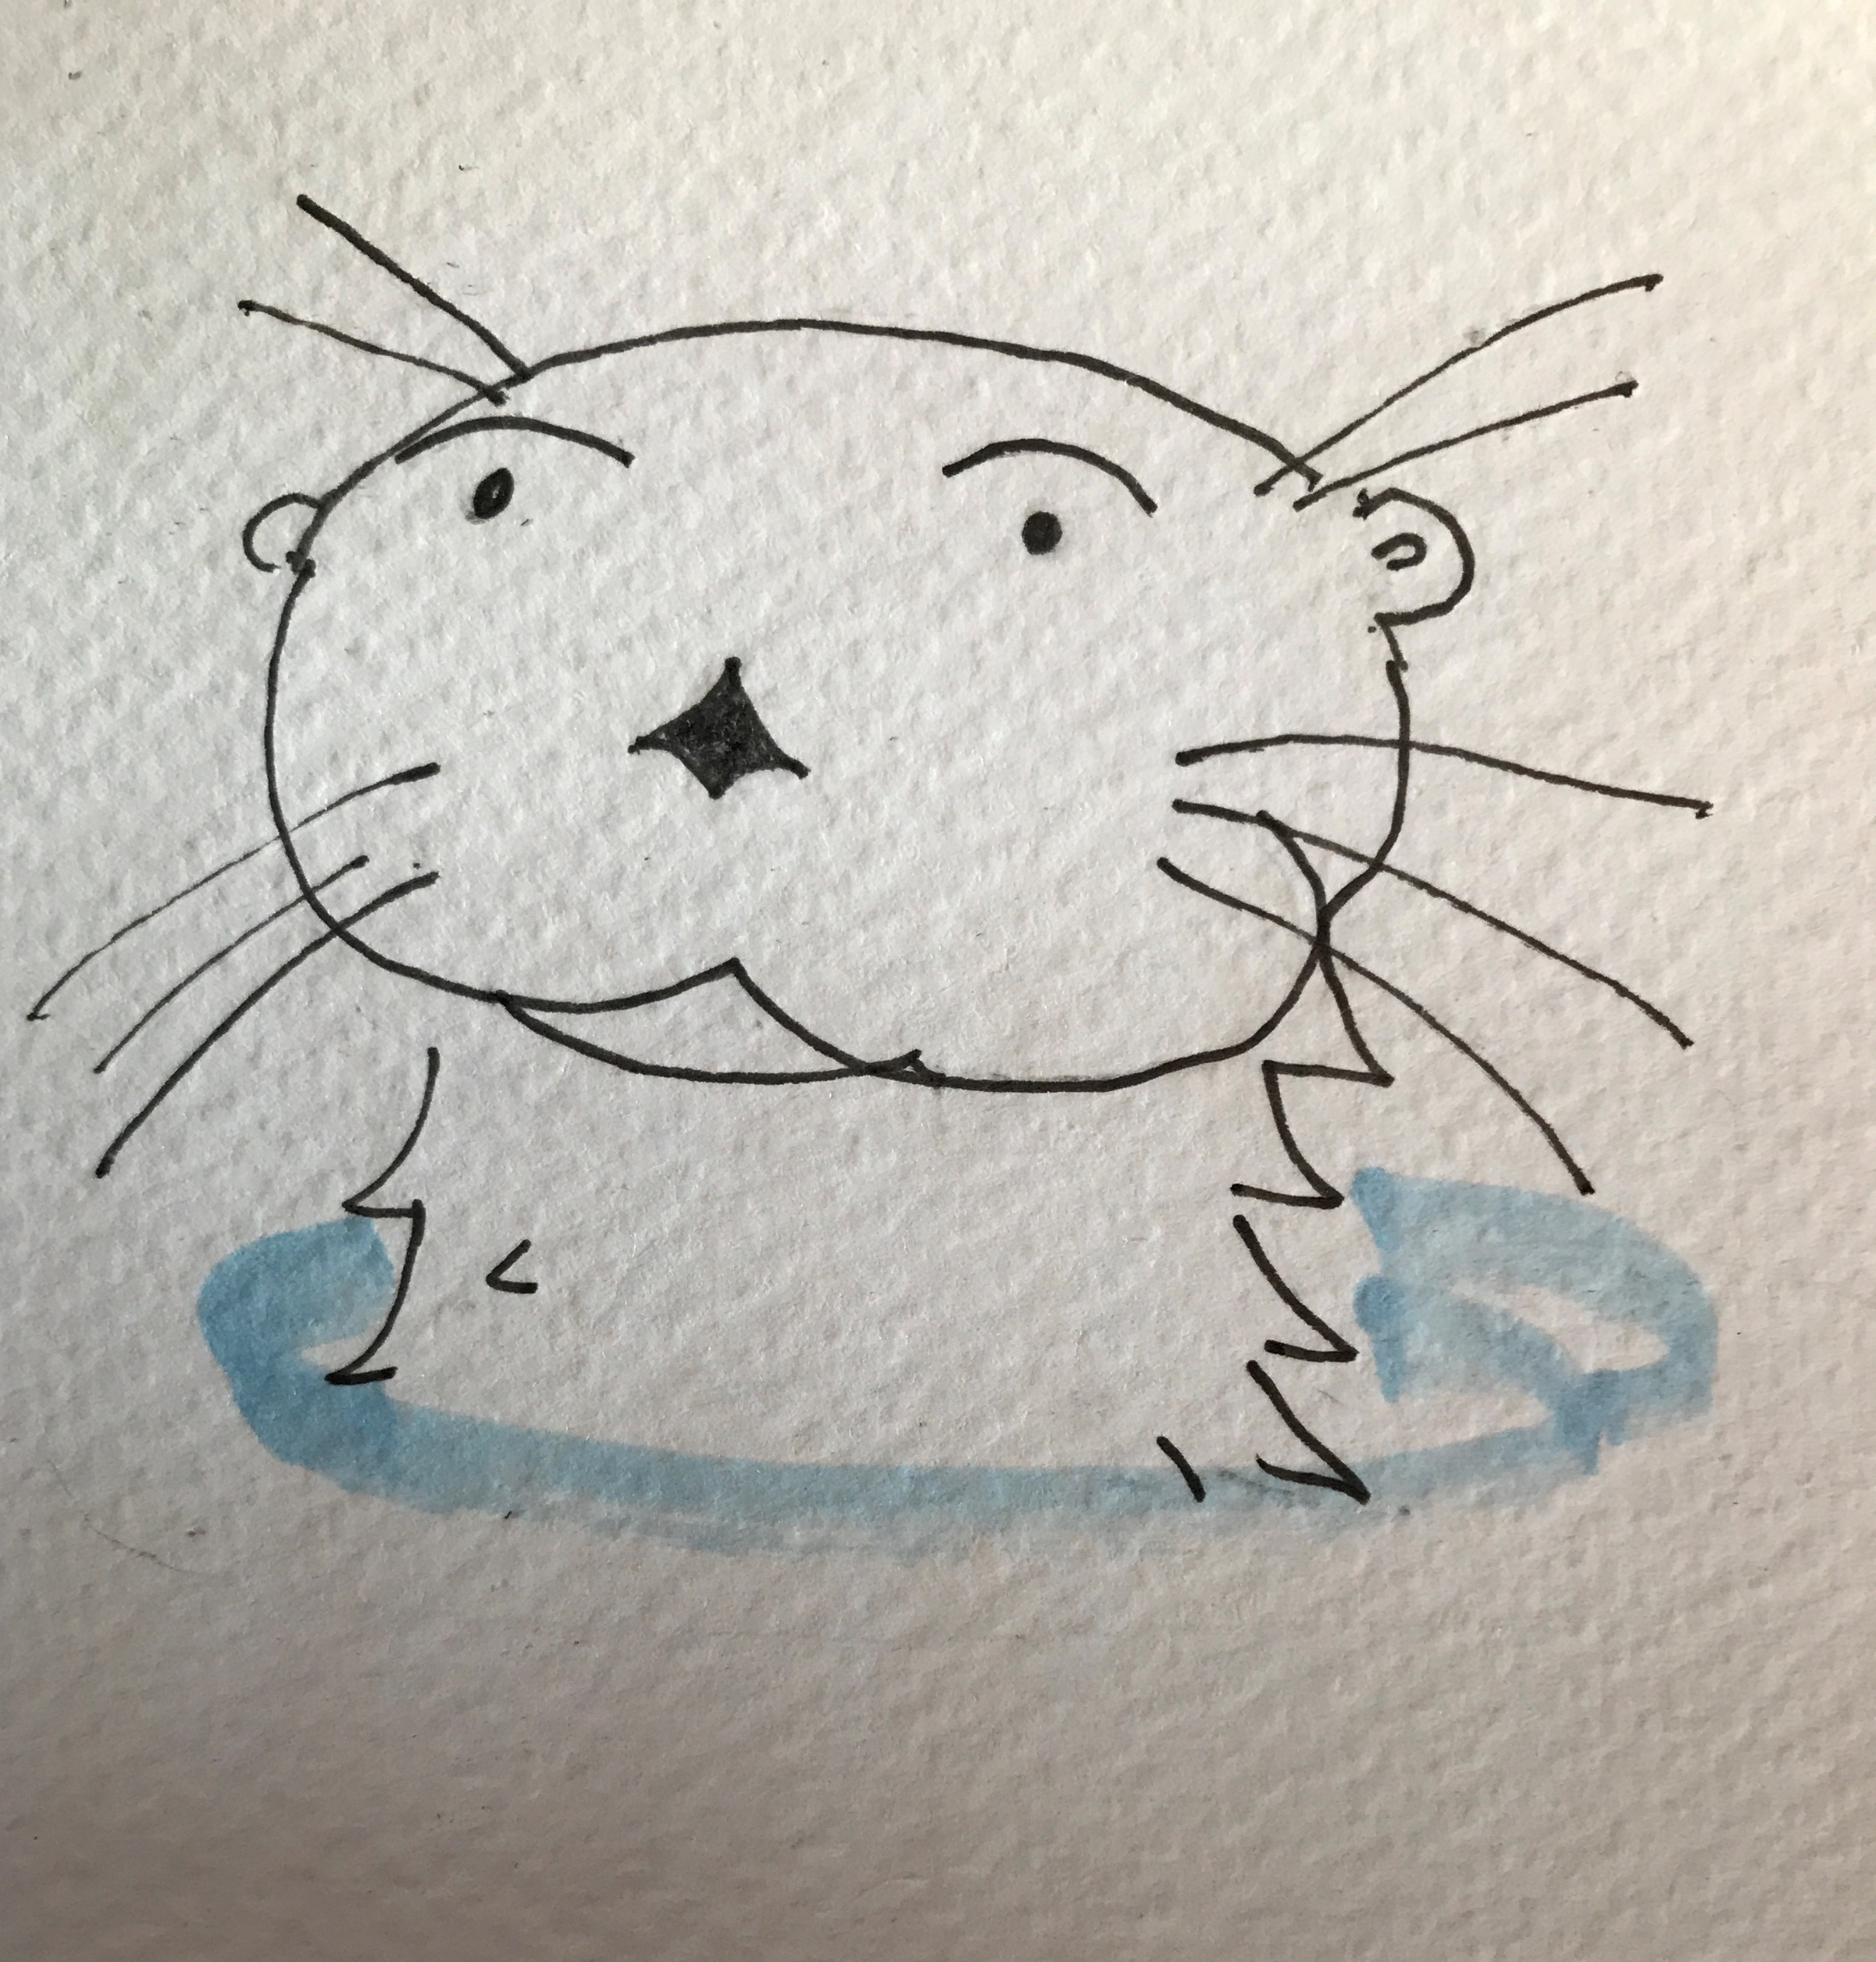
Lontra
Lontra Malting Barley – the New World Otter

